Slide 1
Electronic & Computer Engineering
Division

Slide 2
Feb 2017 Examination Announcement
Activity | Date(s)
Examination Period | 16 to 24 Feb 2017 (Thu – Fri)
Special Examination Period | 27 Feb to 1 Mar 2017 (Mon - Wed)
Release of Examination Results (via NPal and SMS) | 17 Mar 2017, from 8 am onwards
Mailing of Result Slips | 17 Mar 2017 onwards
Review of Examination Results | 20 to 23 Mar 2017 (9am to 5pm)
Appeal against Dismissal/Appeal for Transfer of Course | 20 to 23 Mar 2017 (9am to 5pm)
Term Commencement, Semester 2, AY 2016/2017 | 17 Apr 2017 (Mon)
Refer to NPAL2 for Individualised Examination Timetables and the Examination Rules and Regulation.
You MUST read carefully, no excuses will be accepted if you fail to comply.

Slide 3


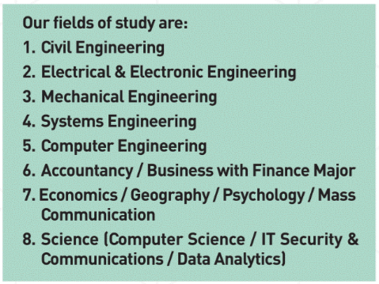

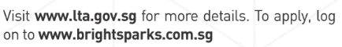

Slide 4
Medical Certificate Submission
IMPORTANT !
Medical Certificate (MC)# MUST be issued by a
government doctor OR
registered medical practitioner
MC MUST be submitted to ECE General Office within 2 working days from the issued date of MC, failing which the MC will not be accepted.
Contact ECE General Office (6460 7819) on the 1st day of medical leave if your medical leave
coverage exceeds 1 day OR
falls within the last 2 days of the examination period
# MC issued by the Traditional Chinese Medicine (TCM) practitioners are NOT considered as valid MC.

Slide 5
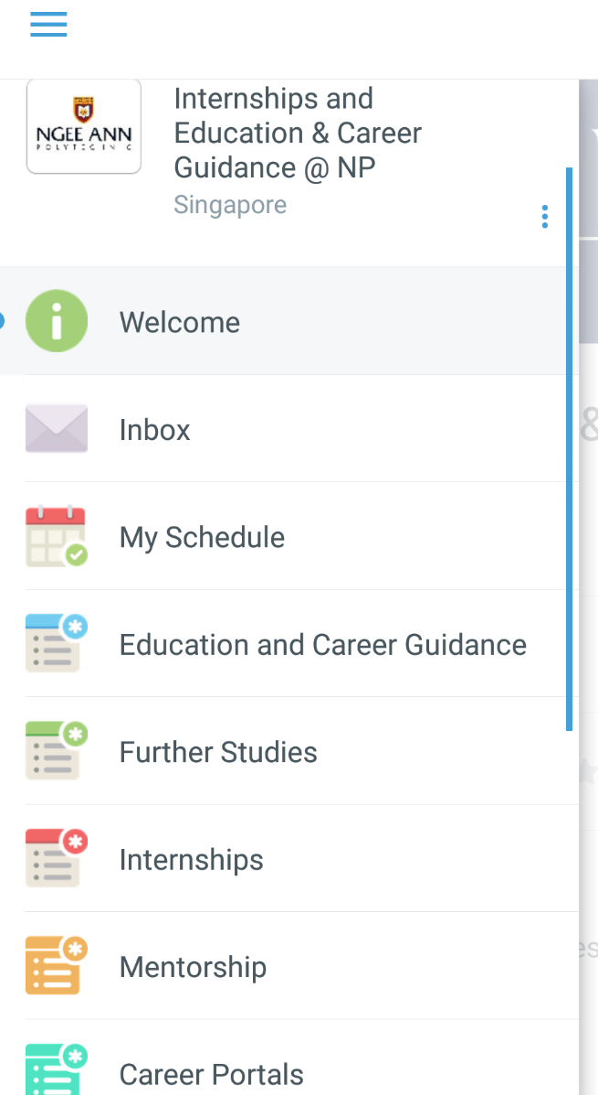
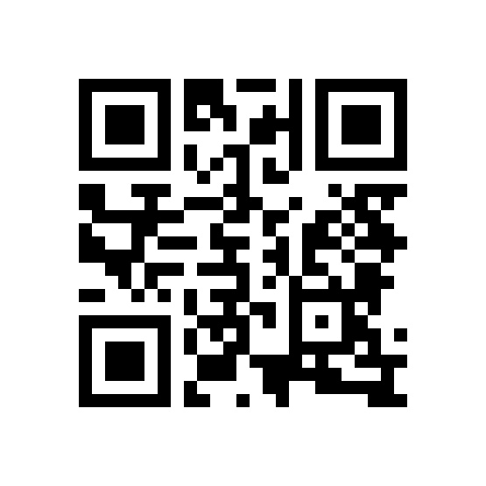

Want to know more about Internships and ECG?
Internships and Education & Career Guidance @NP Guidebook
Download the App via this link or QR code
http://tiny.cc/ECGguidebook

Slide 6
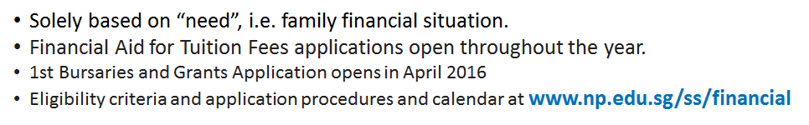
Financial Assistance Schemes
Financial Aid for Tuition Fees | Financial Aid for Living Expenses
Post Secondary Education Account (PSEA) CPF Education Scheme Tuition Fee Loan Tertiary Tuition Fee Subsidy for Malay Student Government Study Loan | Student Aid Grants CDC/CCC Polytechnic Bursary MOE Bursary NP-Administered Donors’ Bursaries PFP Bursary NP Study Loan
Notes:
Comprehensive suite of programmes; solely based on “need”
Financial aid for tuition fees – apply once only, valid for 3 years; subject to availability of funds
Financial aid for living expenses – mass application opens now, from 1 Apr to 30 Apr 2013
Financial aid for others – Mobile Broadband Scheme : for those with no existing broadband

Slide 7
Bursaries & Grants Framework
Student Group | Income Group | Bursary | Student Aid Grant | Total Financial Aid Package
 | MI/HM S$ | S$ | S$ | S$
SC students | 950 or less | 2,000 | 900 | 2,900
 | 951 to 1,200 | 1,500 | 650 | 2,150
 | 1,201 to 1,400 | 1,500 | - | 1,500
 | 1,401 to 1,900 | 750 | - | 750
Permanent Resident students | 800 or less | 500 to 1,500* | - | 500 to 1,500*
Other students | 500 or less | 500 to 1,500* | - | 500 to 1,500*
*Subject to availability of funds. Applicants may be called for an interview
Notes:
Wef AY 2011
Priority will be given to Singaporeans, followed by SPRs/others
Applications will be evaluated on case-by-case basis; interview may be conducted
Strongly encouraged to apply if you meet the MI/HM

Slide 8


Slide 9


Let’s
Keep
Our
Campus
Clean

Slide 10
NP Regulation: Class Attendance & Debarment
Attend all classes and achieve good class attendance.
Lateness is considered as Absent in the computation of attendance.
You can be debarred for a module if your Attendance < 80%.
Debarment of module means you have failed it and you will need to repeat the module again.

Slide 11


Slide 12


Notes:
NOTE: Want a different image on this slide? Select the picture and delete it. Now click the Pictures icon in the placeholder to insert your own image.

Slide 13
Fundraising Activities
IMPORTANT !
DO NOT engage in part-time jobs involving seeking donations from the public as you may be charged for fraud and illegal canvassing for donations.
DO NOT use your NP student card in activities not organised or approved by NP.
Please be wary when companies/organisations are asking you to seek minimum amount of donations related to NP. When in doubt, please clarify with ECE General Office at Ext. 8021
Disciplinary actions will be taken if you flout the rules.
Notes:
For Foreign MC, HR will look at them on a case by case basis. MC may be from government hospital or registered medical practitioner.

Slide 14
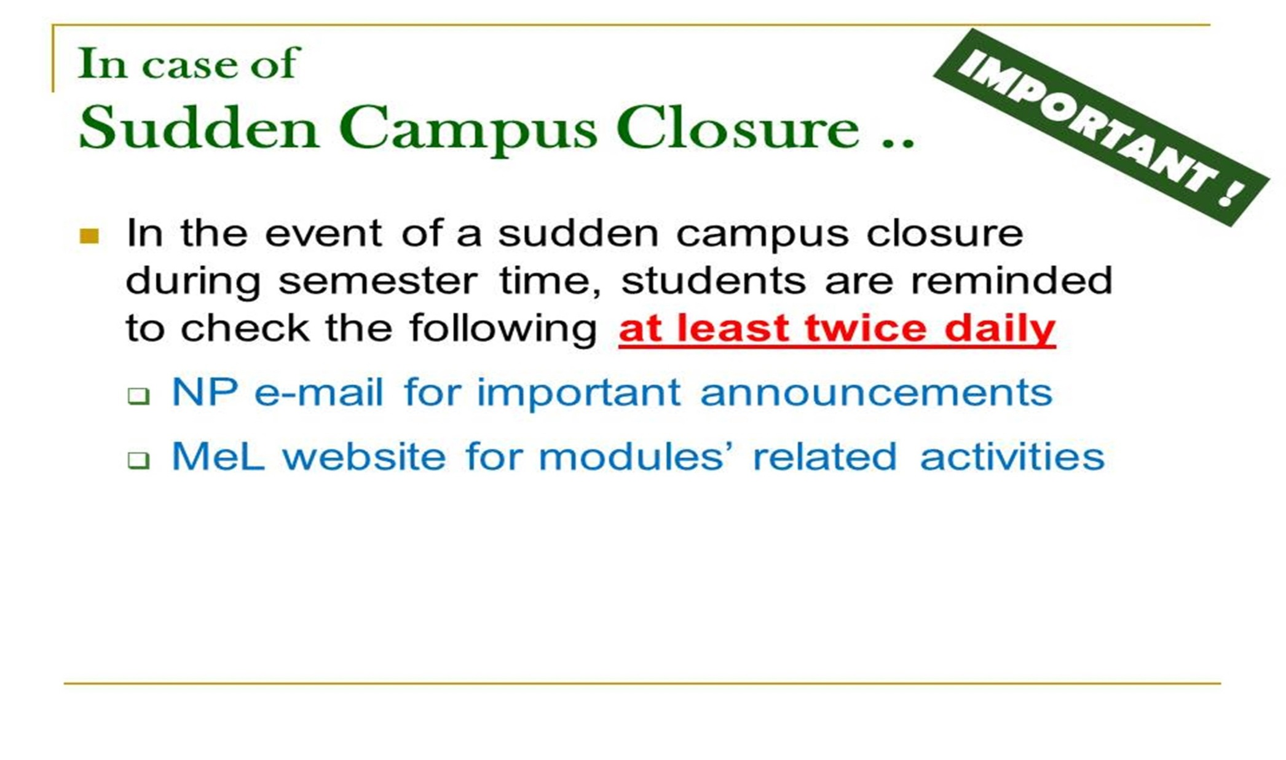

Slide 15
